Slide 1

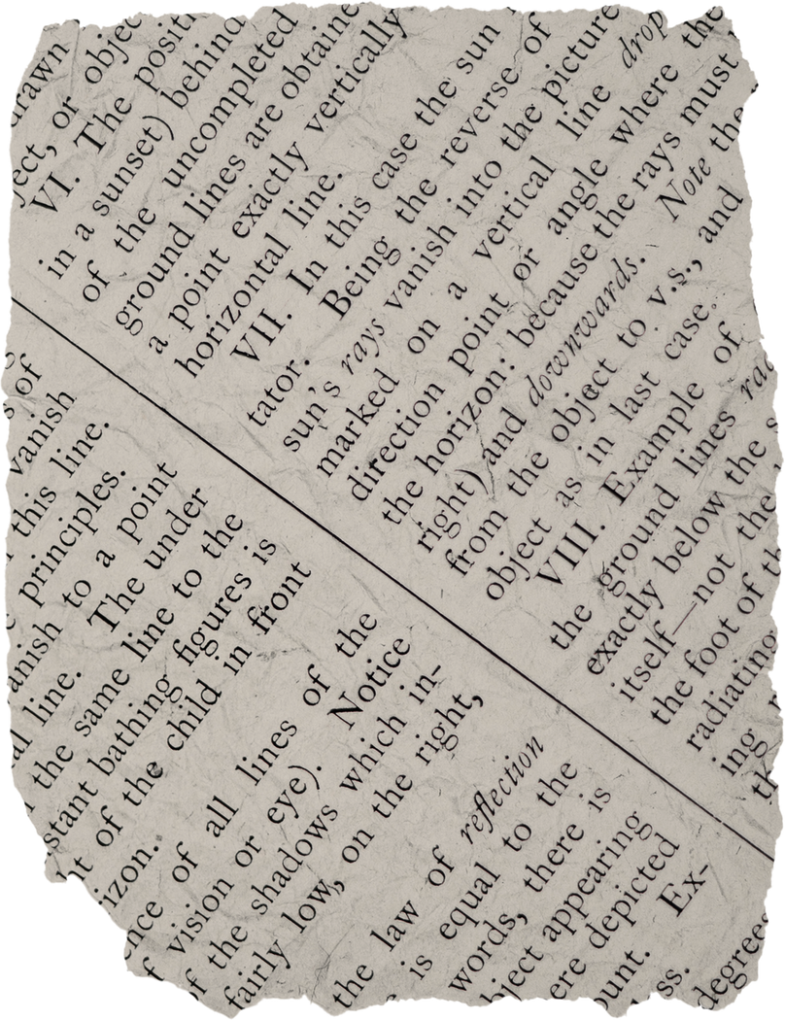
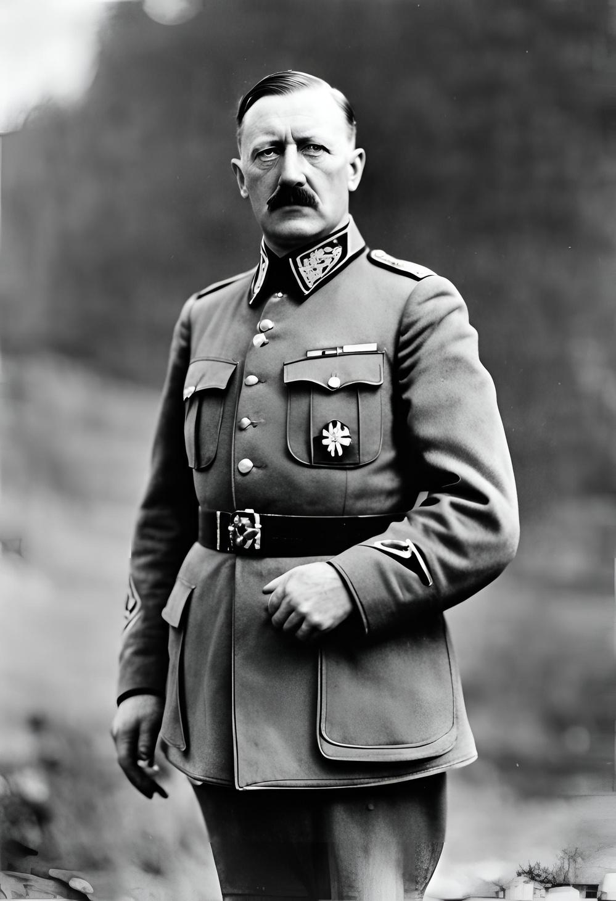
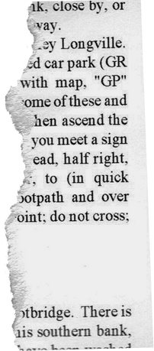



Adolf
Hitler
Two Paths, Two Legacies: The Ideological Divide Between Hitler and Gandhi

Slide 2
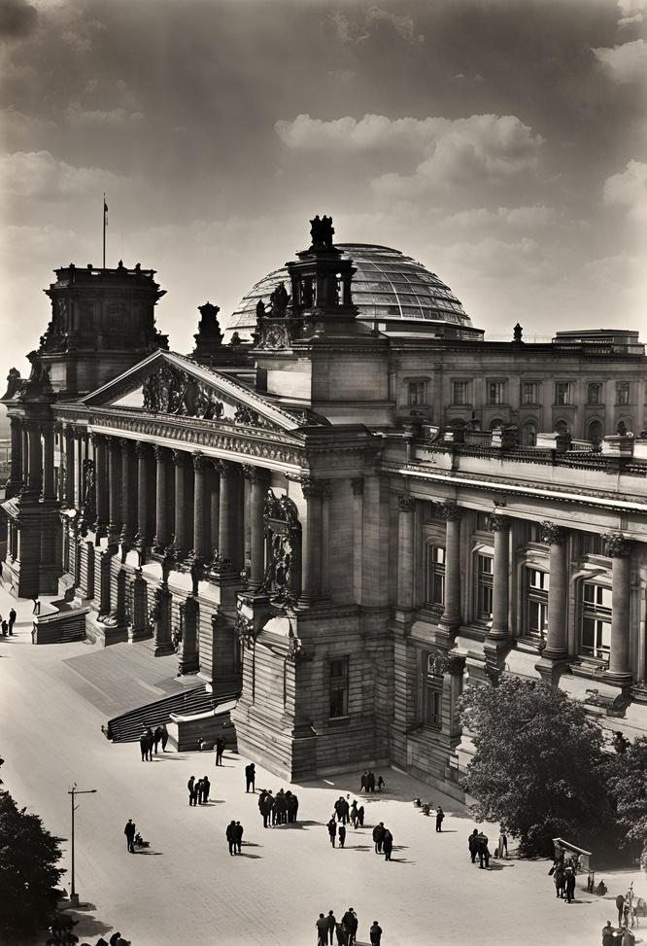
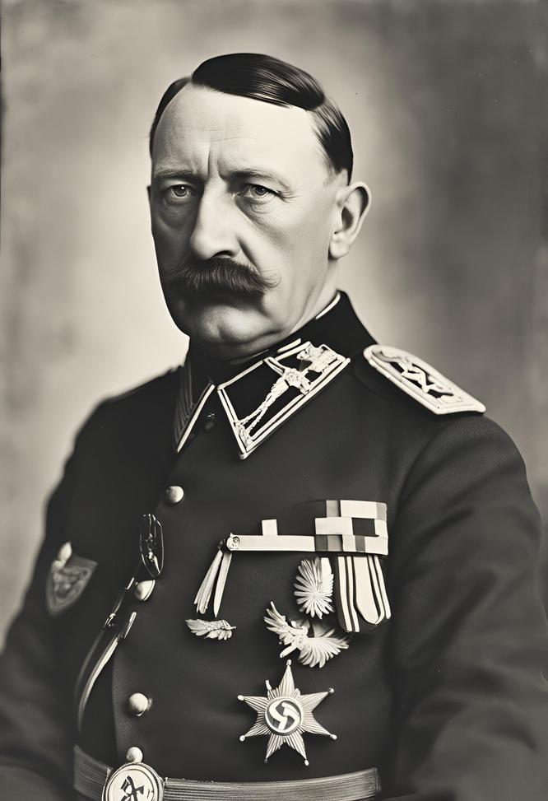
Understanding
the Context
Adolf Hitler, the leader of the Nazi Party, rose to power in Germany during a tumultuous period in history. Understanding the political, economic, and social context of the time is essential to comprehend the factors that contributed to his rise to power and the catastrophic consequences of his reign.

Slide 3
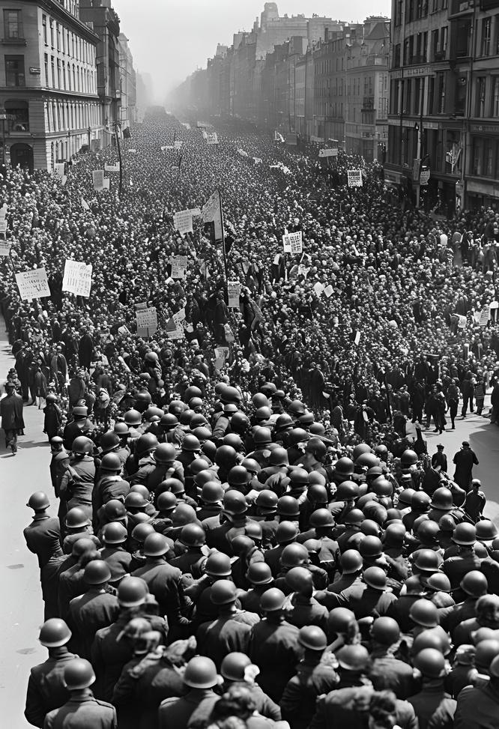
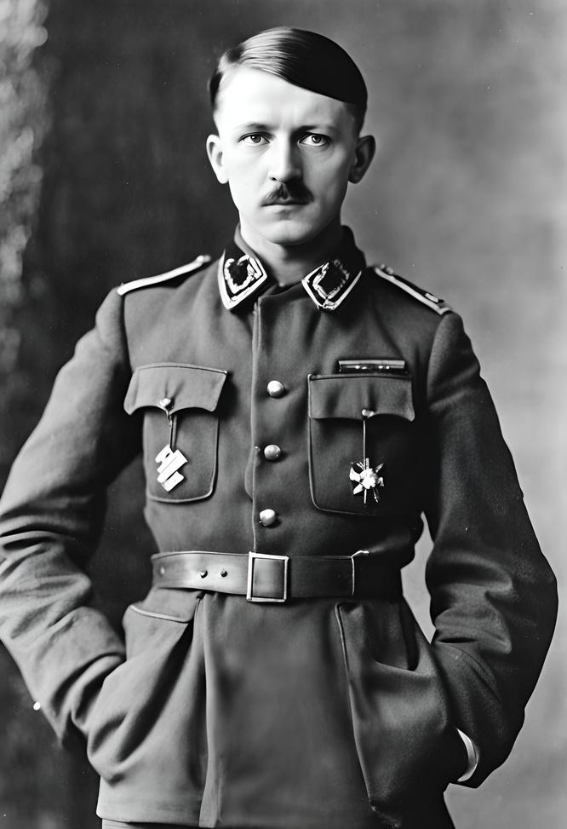
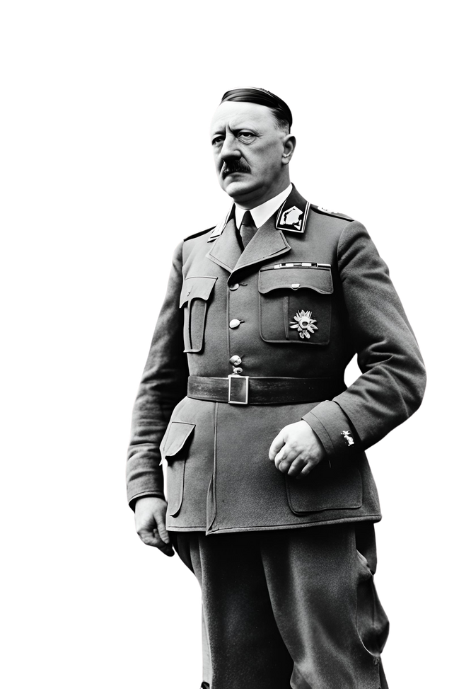
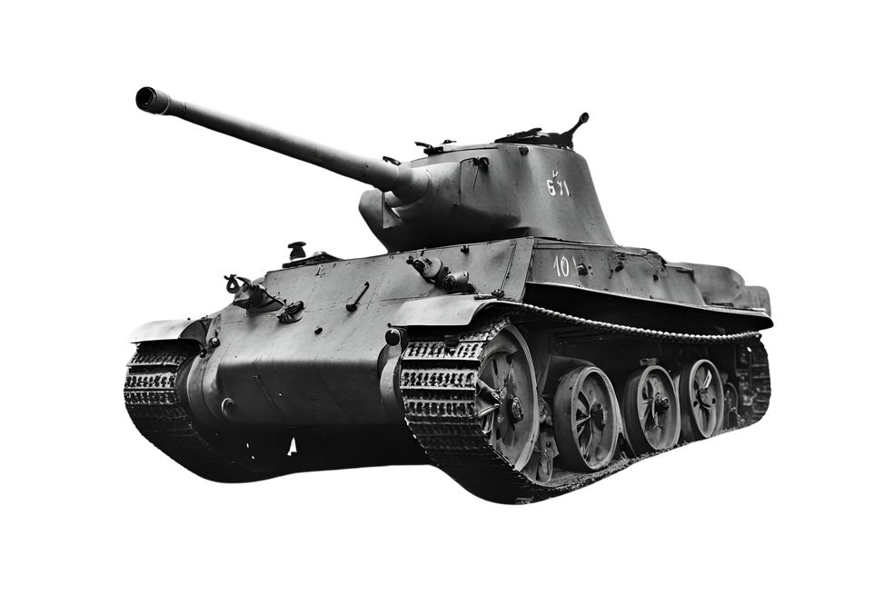

Early Life
The Making of a Dictator
Adolf Hitler, the leader of the Nazi Party, rose to power in Germany during a tumultuous period in history. Understanding the political, economic, and social context of the time is essential to comprehend the factors that contributed to his rise to power and the catastrophic consequences of his reign.

Slide 4
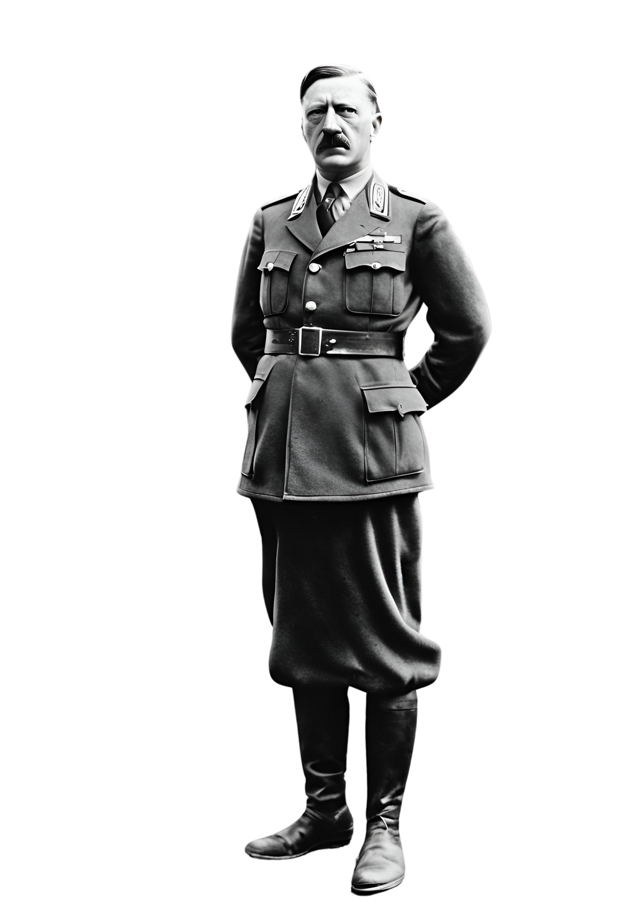
From Chancellor
to Dictator
In 1933, Hitler was appointed Chancellor of Germany by President Paul von Hindenburg. Using legal and political maneuvers, as well as intimidation and violence, Hitler swiftly consolidated his power and eliminated political opposition.
The Reichstag Fire Decree and the Enabling Act granted Hitler dictatorial authority, effectively marking the end of democracy in Germany and the beginning of Nazi tyranny.

Slide 5
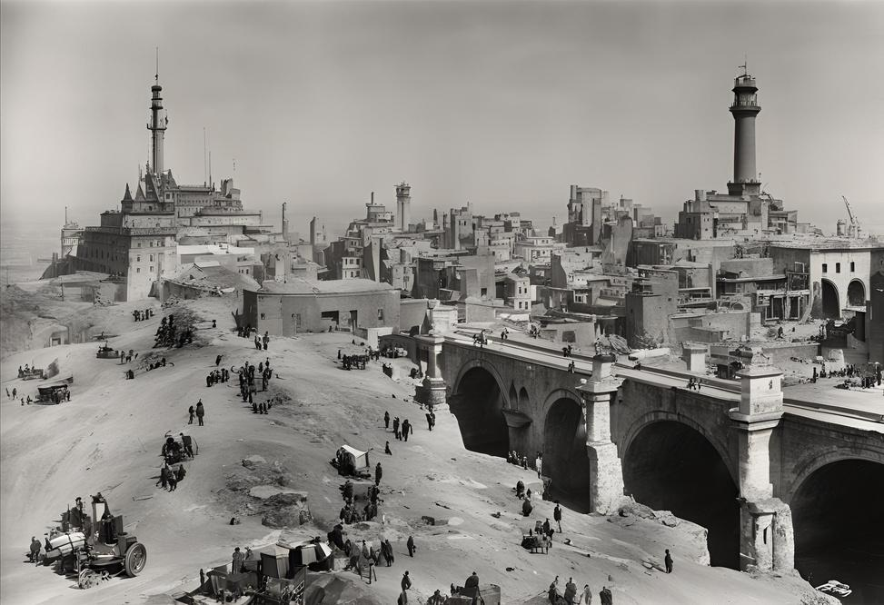
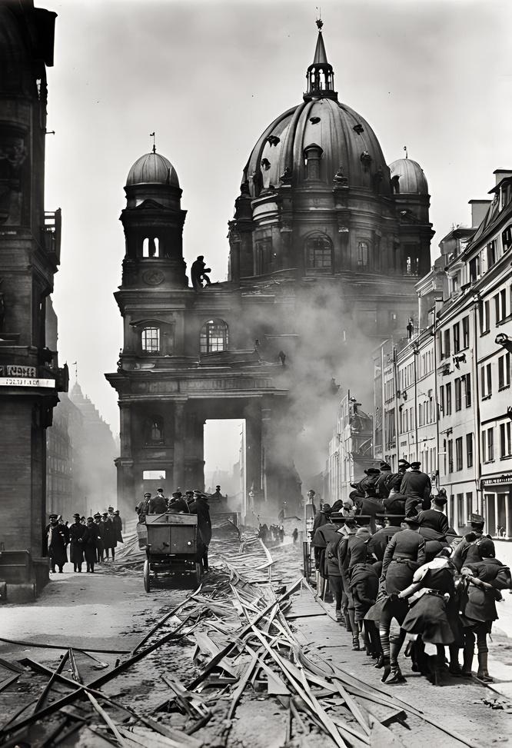
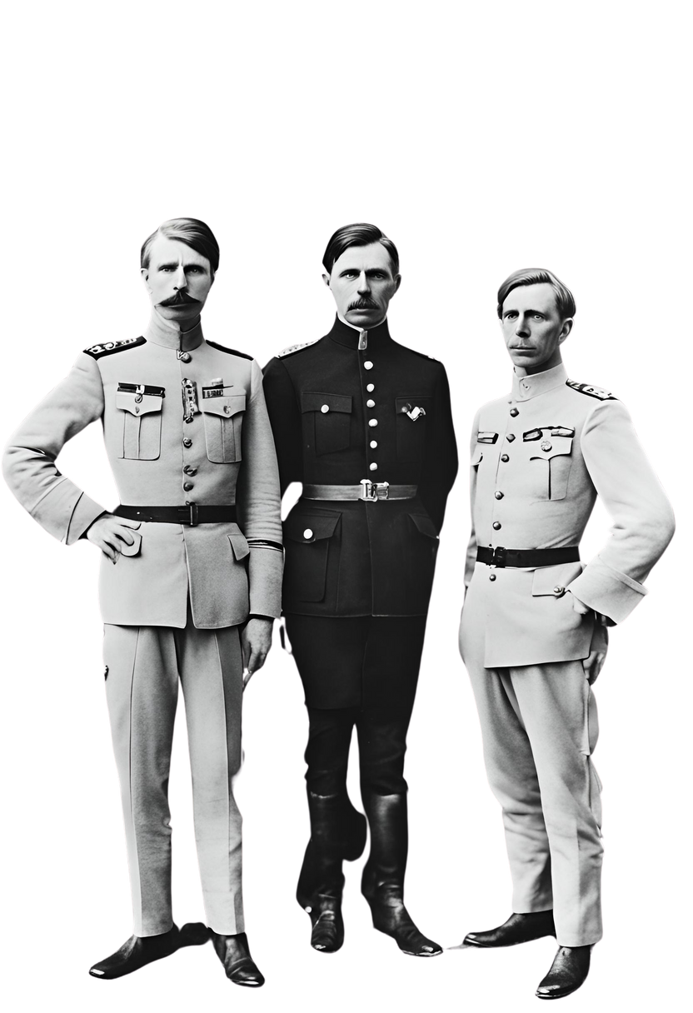
World War I
The Great War and Its Aftermath
During World War I, Hitler served as a soldier in the German army, where he was decorated for bravery and wounded in combat. The war's end in 1918 left Germany in a state of political and economic turmoil, with widespread discontent and social unrest. Hitler's experiences during the war and its aftermath would later fuel his political ambitions and extremist ideologies.

Slide 6
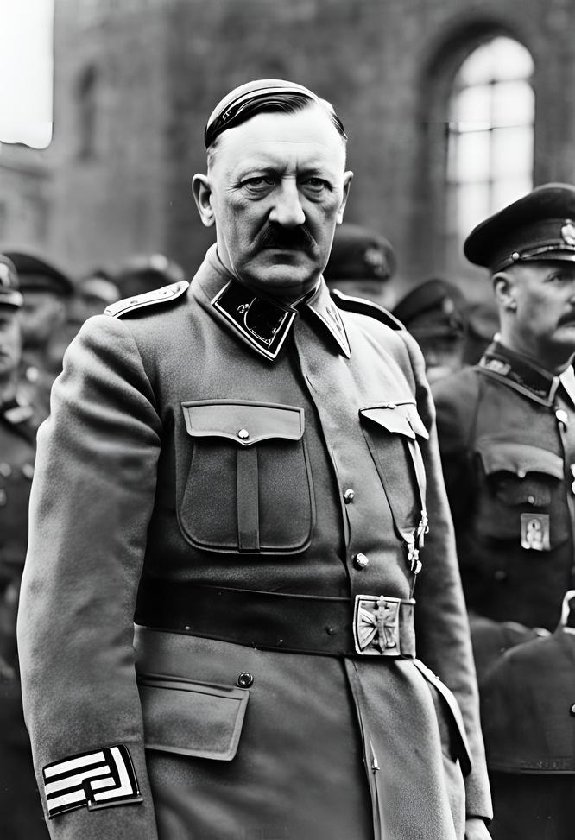
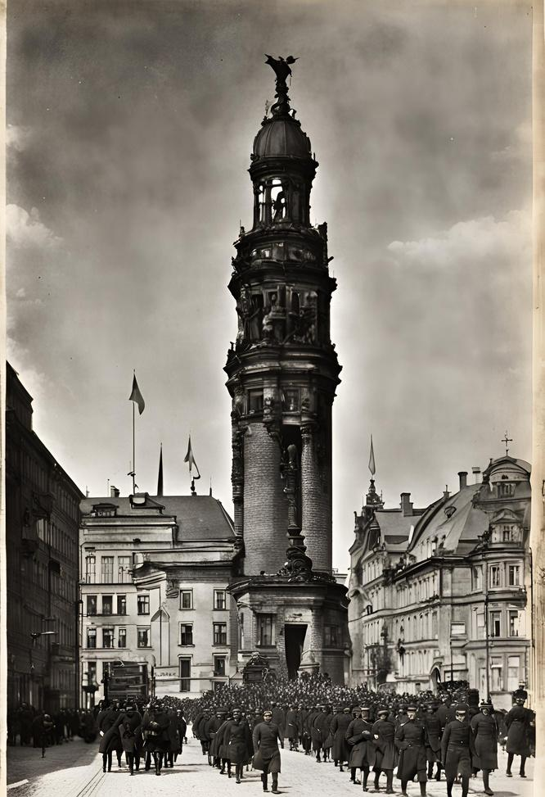
Seeds of Hatred
and Nationalism
In the aftermath of World War I, Germany experienced a period of instability and economic hardship. Amidst this turmoil, Hitler found a fertile ground for his nationalist and anti-Semitic beliefs. In 1919, he joined the German Workers' Party, which would later evolve into the National Socialist German Workers' Party, or Nazi Party. Hitler's charismatic leadership, fiery rhetoric, and extremist ideology propelled him to prominence within the party, laying the foundation for his ascent to power.

Slide 7
The Rise of the Nazi Party
Post-War Turmoil:
Germany faced instability and economic hardship after World War I, creating a breeding ground for discontent and radical ideologies.
Hitler's Ideology:
Adolf Hitler capitalized on this unrest, promoting nationalist and
anti-Semitic beliefs that resonated with disillusioned citizens.
Party Formation:
In 1919, Hitler joined the German Workers' Party, which later transformed into the National Socialist German Workers' Party, or Nazi Party.
Hitler's Leadership:
Through impassioned speeches, and extreme ideology, he quickly rose to prominence within the party, laying the groundwork for his rise to power.

Slide 8
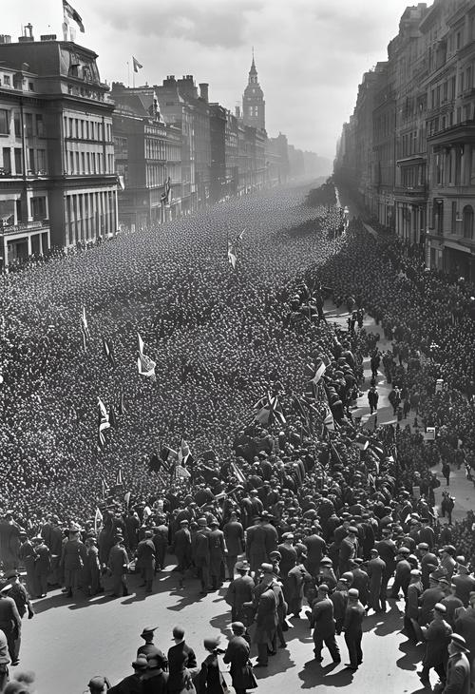
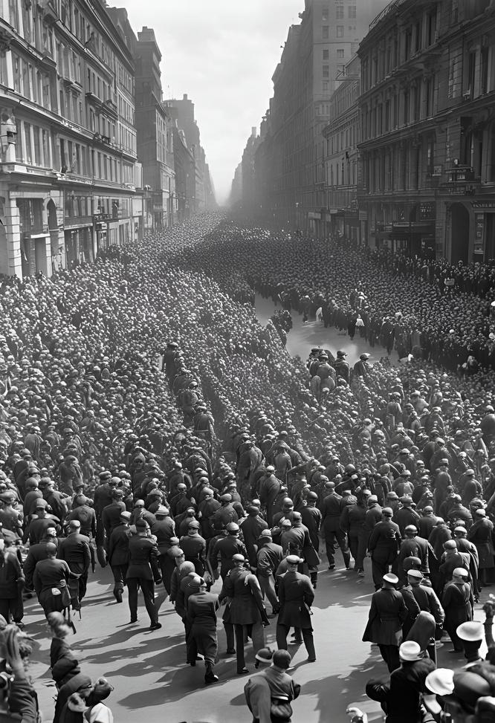
Manipulating Minds, Cultivating Support
Manipulating Minds, Cultivating Support
Hitler and the Nazi Party employed sophisticated propaganda techniques to manipulate public opinion and garner support for their extremist agenda. Through rallies, speeches, posters, and media, they spread nationalist, anti-Semitic, and militaristic messages, appealing to emotions and prejudices. This propaganda machine played a crucial role in shaping public perception and consolidating Hitler's power.

Slide 9
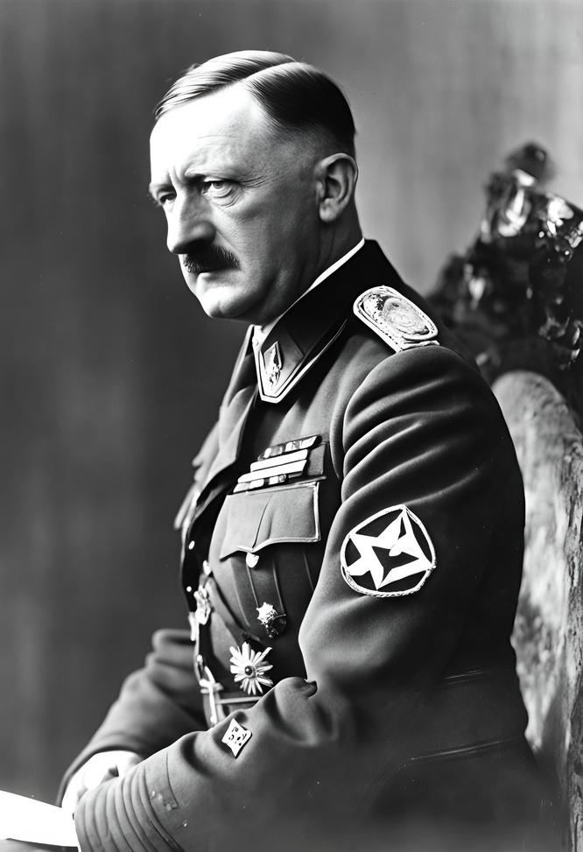
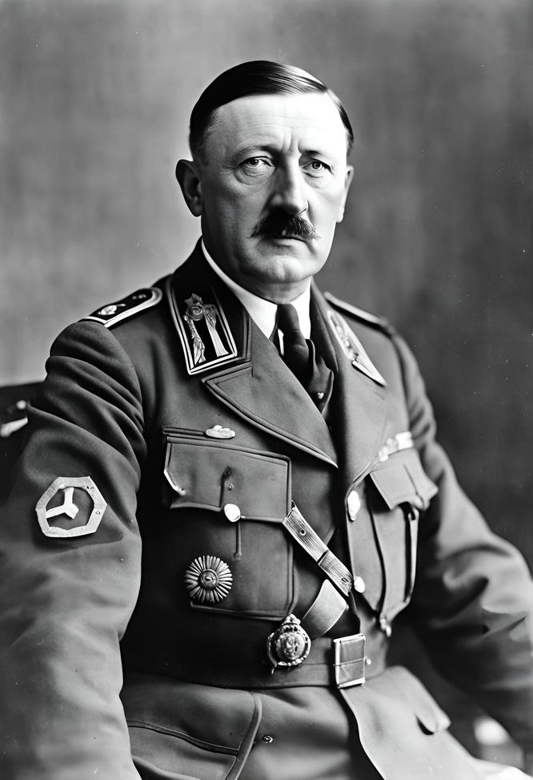
Appointment as Chancellor
Consolidation of Power
In 1933, Adolf Hitler was appointed Chancellor of Germany by President Paul von Hindenburg, leveraging his growing influence within the Nazi Party.
Through legal and political maneuvers, intimidation, and violence, Hitler swiftly eliminated political opposition and consolidated his power, centralizing authority under the Nazi regime.
Reichstag Fire Decree and Enabling Act
Hitler exploited the Reichstag fire in February 1933 to push through the Reichstag Fire Decree, suspending civil liberties and enabling the suppression of political opponents. Subsequently, the Enabling Act granted Hitler dictatorial authority, effectively ending democracy in Germany and paving the way for Nazi tyranny.

Slide 10
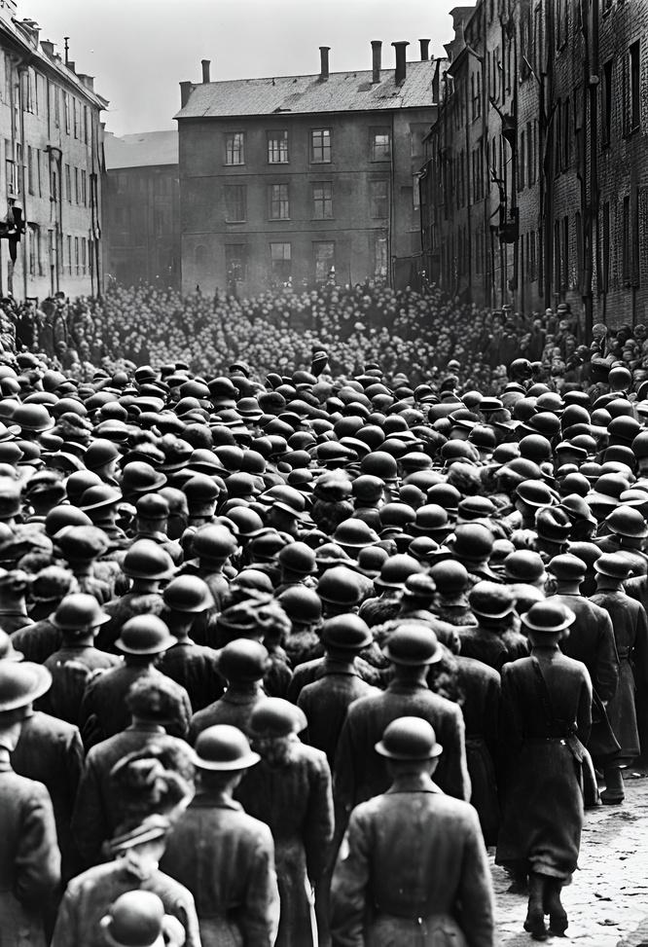
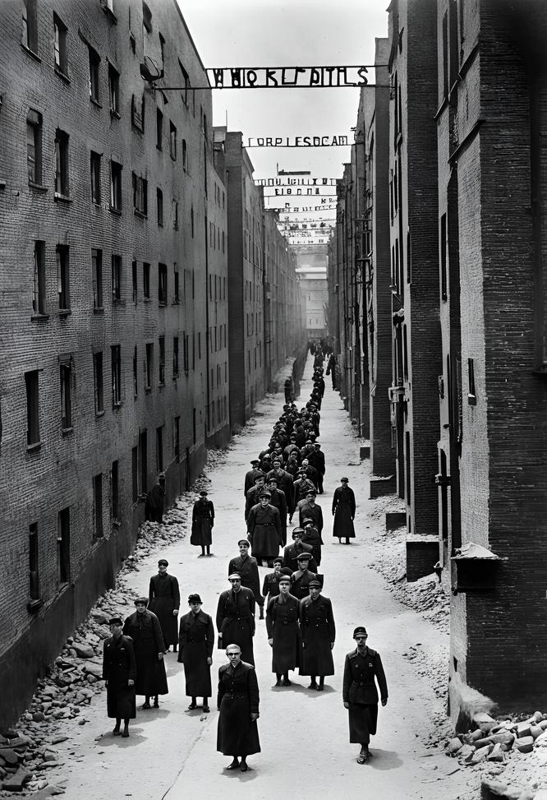
The Holocaust
Humanity's Darkest Chapter
Hitler's anti-Semitic beliefs and policies culminated in the Holocaust, the systematic genocide of six million Jews, as well as millions of other victims, including Roma, disabled individuals, political dissidents, and others deemed "undesirable" by the Nazi regime. The atrocities committed during the Holocaust serve as a chilling reminder of the consequences of hatred, bigotry, and unchecked power.

Slide 11
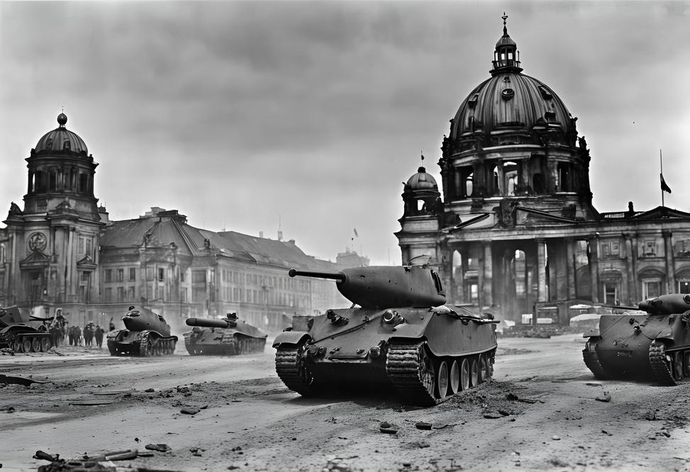
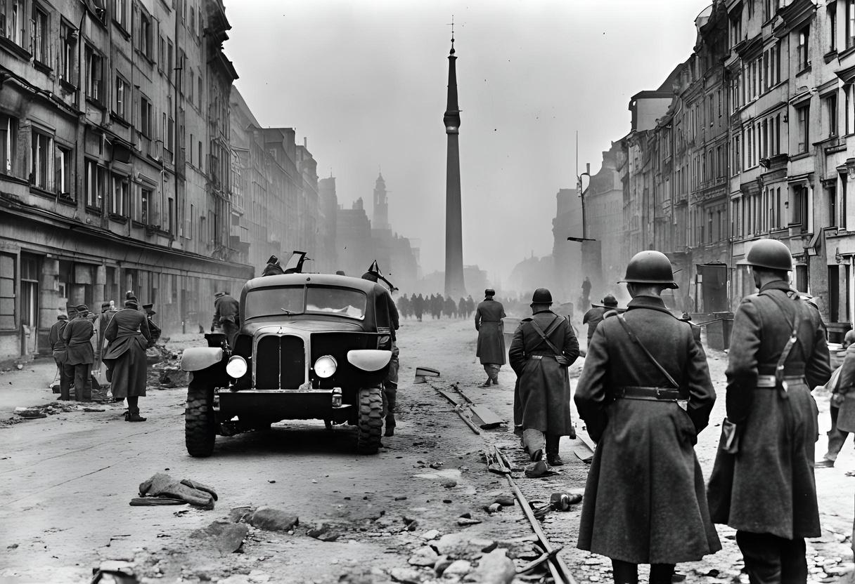
World War II
Hitler's expansionist ambitions and aggressive foreign policies precipitated the outbreak of World War II in 1939. The conflict engulfed much of the world, resulting in unprecedented devastation, loss of life, and suffering.
Hitler's military strategies and atrocities, including the invasion of Poland, the Blitzkrieg, and the Holocaust, left an indelible mark on history and forever changed the course of the 20th century.

Slide 12
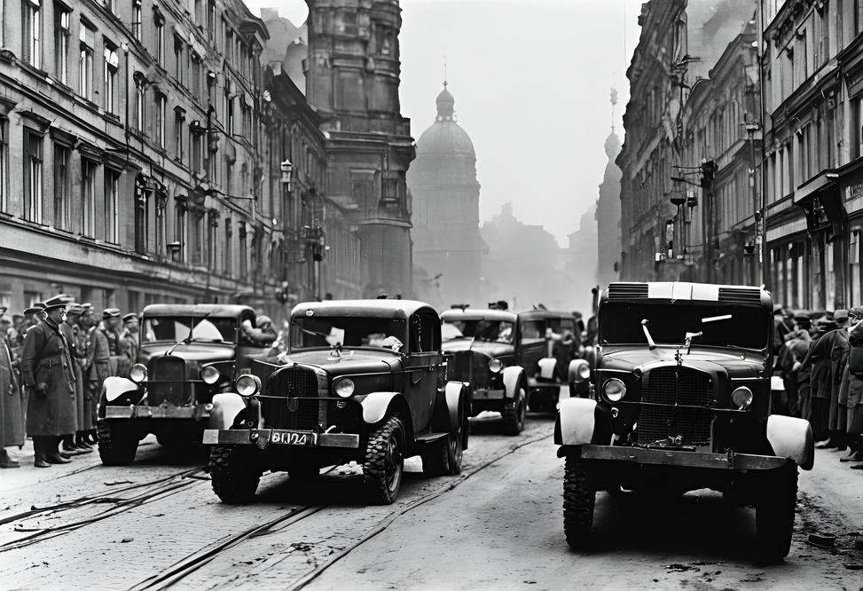
Defeat
and Damnation
As Allied forces advanced on Germany, Hitler's regime crumbled under the weight of defeat. On April 30, 1945, facing certain capture, Hitler committed suicide in his bunker in Berlin. The end of the war marked the defeat of Nazi Germany and the liberation of Europe from tyranny. Hitler's legacy remains one of infamy and horror, serving as a stark warning of the dangers of unchecked authoritarianism, extremism, and hatred.

Slide 13
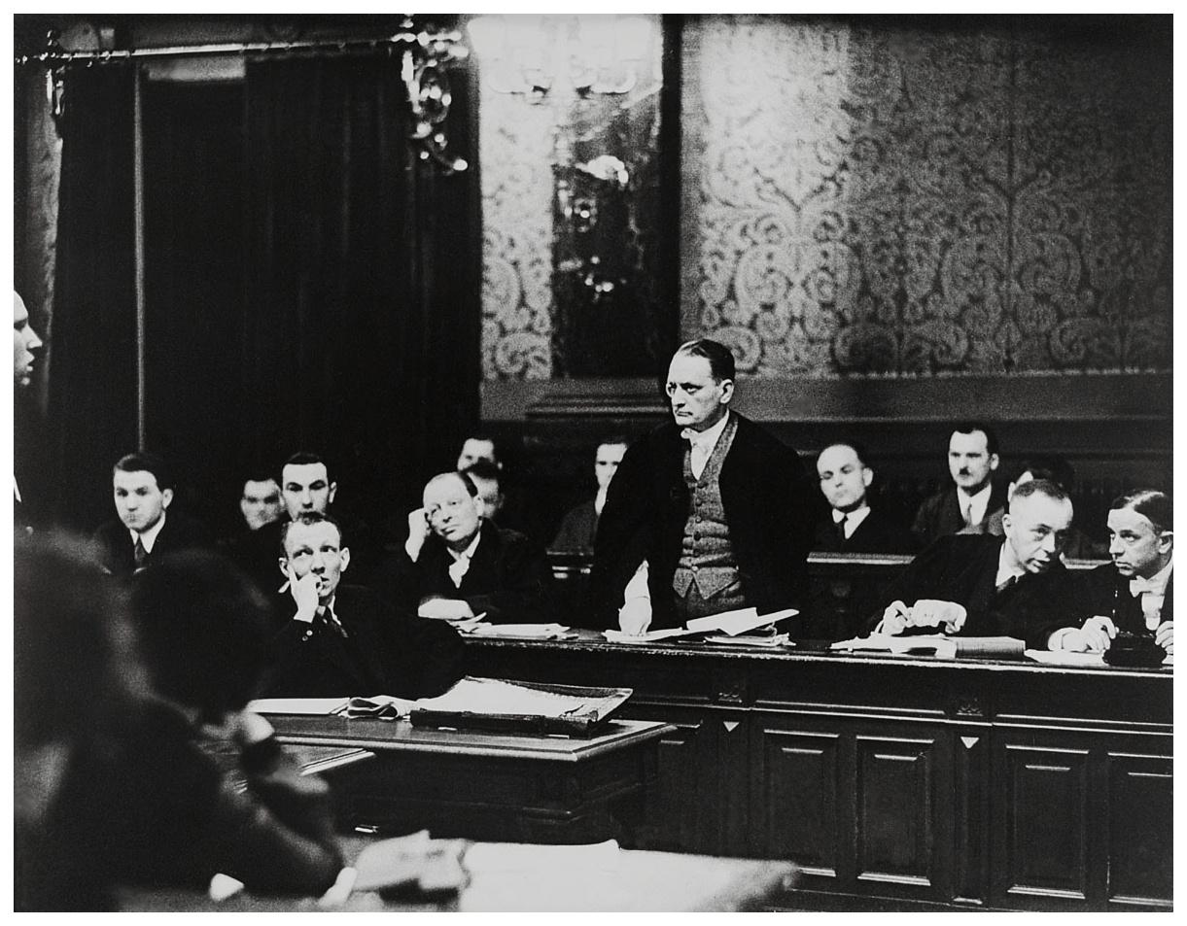
Nuremberg
Trials
In the aftermath of World War II, the Allies held the Nuremberg Trials to prosecute prominent leaders of Nazi Germany for war crimes, crimes against humanity, and other atrocities committed during the Holocaust. Several high-ranking Nazi officials, including Hermann Göring and Rudolf Hess, were convicted and sentenced for their roles in perpetrating the horrors of the Holocaust and waging aggressive war.

Slide 14
Honoring the Victims, Preserving Memory
Throughout the world, memorials, museums, and educational programs serve as reminders of the victims of the Holocaust and the atrocities committed under Hitler's regime. These efforts aim to preserve memory, educate future generations, and honor the millions of lives lost to hatred, bigotry, and intolerance.

Slide 15
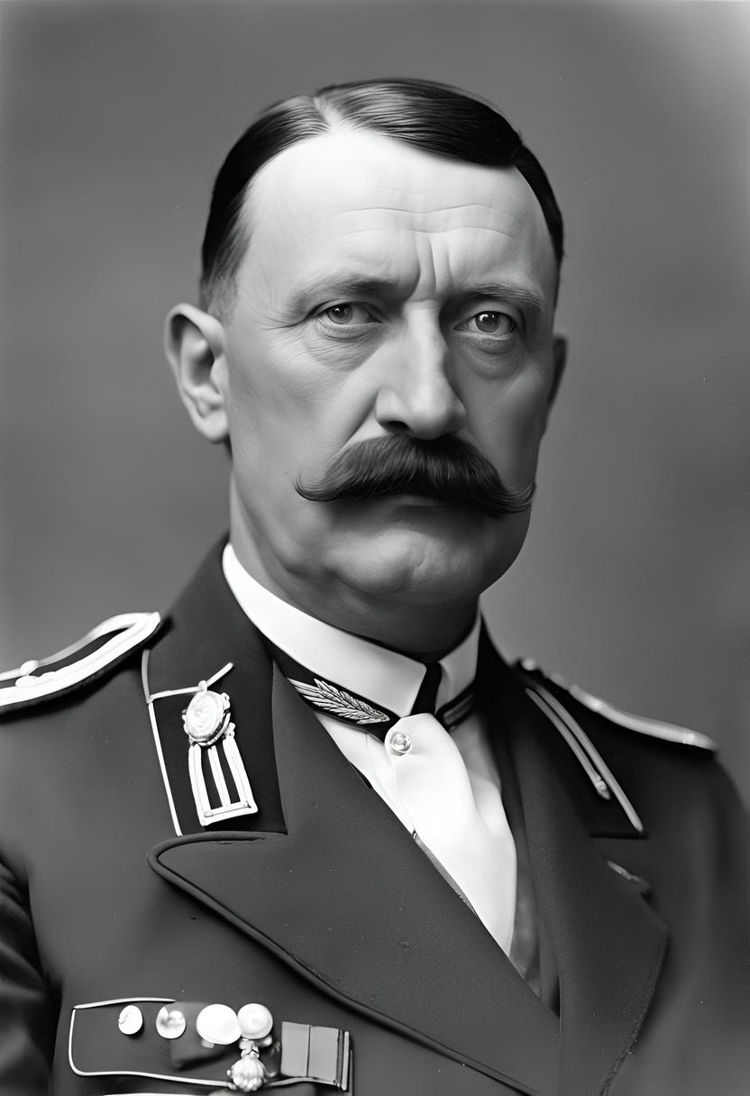
Remembering
the Past
As we conclude our journey through the life and legacy of Adolf Hitler, let us reflect on the profound impact of his reign of terror and the lessons learned from this dark chapter in history. May we remain vigilant against the forces of hatred and extremism, and strive to build a world guided by tolerance, compassion, and respect for all humanity.

Slide 16
Hitler: The Tyrant’s Reign,
Gandhi: The Peaceful Revolution.

Slide 17
Approach to Power
Hitler's Ideology:
Advocated for authoritarianism and totalitarian control, using fear, propaganda, and violence to maintain power.
Gandhi's Ideology:
Promoted democracy and self-rule, emphasizing civil disobedience and nonviolent resistance.

Slide 18
Philosophy on Violence
Hitler's Ideology:
Believed in the use of force and militarism to achieve and maintain objectives.
Gandhi's Ideology:
Firmly adhered to ahimsa (nonviolence) and believed that true change could only come through peaceful means.

Slide 19
Racial and Social Views
Hitler's Ideology:
Endorsed racial superiority, specifically Aryan supremacy, and implemented policies of racial discrimination and genocide.
Gandhi's Ideology:
Advocated for the equality of all races and social classes, fighting against discrimination and promoting universal brotherhood.

Slide 20
Economic and Social Policies
Hitler's Ideology:
Emphasized a centralized economy focused on war production and territorial expansion.
Gandhi's Ideology:
Supported a self-sufficient village economy, promoting sustainable living and economic independence.

Slide 21
Vision for Society
Hitler's Ideology:
Sought to create a homogeneous society based on racial purity and nationalistic ideals.
Gandhi's Ideology:
Envisioned a pluralistic and inclusive society where different religions and cultures coexisted harmoniously.

Slide 22

That concludes our presentation.
Thank You
Scan Here to get
The copy of the Presentation.
By Sujith S : 22MIY0046

